Slide 1
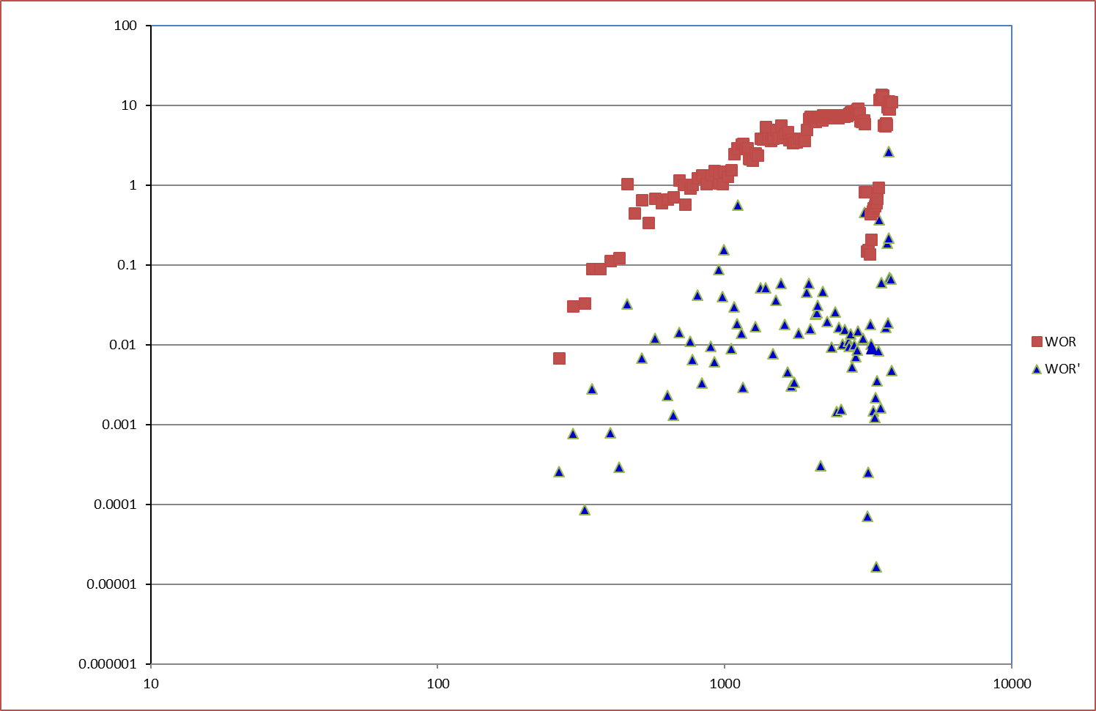
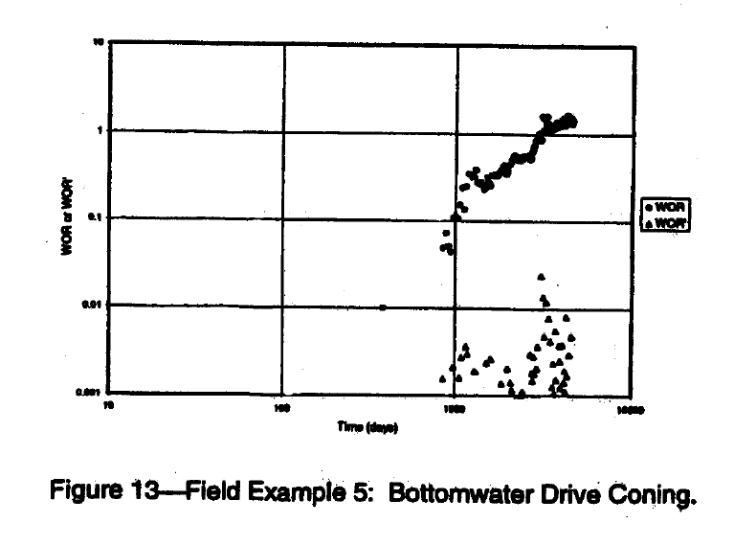
Title: Dedicated Individual Drainage Point Review of Closed in Well: TUNU002S to Add 300bopd (risked) Gains at Zero Cost
Business Case/objectives:
Increase Tunu production by 300 (risked) through identified open up opportunity
The opportunity was identified through detailed review of closed in wells in TUNU node following open up of flowstation.
The FMT performance review of TUNU002S indicated that the water produced by well is due to bottom water coning
Potential Benefits & Measurement:
300bopd (Risked)
Project Sponsor: Gogo Eneyok
Project members:
Etokakpan Eteobong (Lead),
Osazuwa, Uyiosa, Chukwuma Obianuju, Umeh Esther,
Esharegharan Ovokerhoyi, Okpere Adrian, Baranu Suka, Itene Gaga
High-level Timeline:
L0-L1: July 10 2019
Critical Success Factors:
Timely response to open up notification from DPR
Optimized bean for open up
CCU Availability
Project Scope/Actions :
Carry out integrated well and reservoir performance review
Build model to determine gain from open up
Carry out well head and flowline surveillance activities
Draft and issue open up notification letter to DPR
Share execution sequence with programmer and operations.
Source open up bean size
Implement open up opportunities and test intervals
Optimize bean size to potential
Report gains
SUBSURFACE ANALYSIS
Only interval completed on the reservoir and was closed in for flare gas control in January 2012. it was also producing at HBSW of 92%
Well performance review indicates the well has bottom water coning – see Chan plot above
The HGOR reported for the well was due to slippage after well was beaned down to manage water production
Well performance shows water receded after 3yrs of shut in during ND crisis (90% - 12% BSW) and produced for ca. 3yrs before shut in
Well has been shut in since 2012 (6½Years).
Prosper model indicates well can produced 300bopd (risked) at 90% BSW
SURFACE ANALYSIS
CITHP of well in June 2019 indicates an healthy CITHP of 1230psig.
Flowline is available and integral
Well is integral – all well head valves passed OK. TUNU002L is currently on production.
CCU replacement is required to open well to flow

